Slide 1

Lok Sabha Elections Analysis
2014 & 2019

Slide 2
About Project
Atliq Media is a private company who wanted to telecast a show on the Lok Sabha Elections of
2014 and 2018. They wanted to present unexplored insights from the elections as a show.

Slide 3
Dataset Overview
dim_states_codes
Gives information regarding the states of India
constituency_wise_results_2014, constituency_wise_results_2019
Gives information regarding the various constituencies, their states, candidates who participated in the election
their respective parties, their age ,category, the number of votes they got including general and postal votes and the total number of electors in the constituencies for the Lok Sabha Elections 2014 and 2019 respectively.

Slide 4
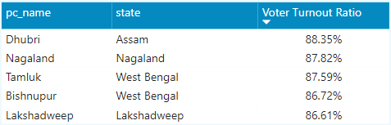
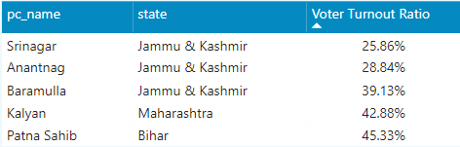
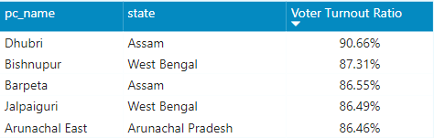
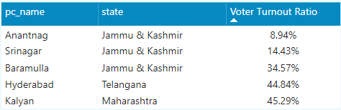
1. List top 5/bottom 5 constituencies of 2014 and 2019 in terms of Voter Turnout Ratio
For 2014,
For 2019,

Slide 5
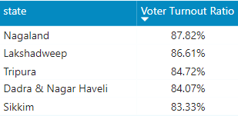
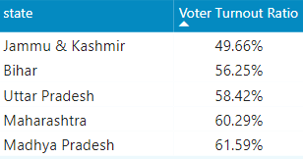
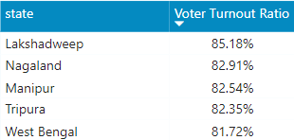
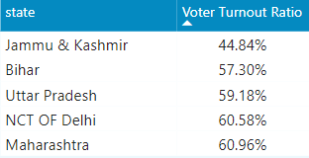
2. List top 5/bottom 5 states of 2014 and 2019 in terms of Voter Turnout Ratio
For 2014,
For 2019,

Slide 6
Voter Turnout Ratio
Voter Turnout Ratio is the polling percentage of an election given by
Voter Turnout Ratio = DIVIDE([Total Votes],[Total Electors],0)
The North-eastern parts of India have shown the highest polling percentage in both the elections.
Dhubri and Bishnupur have consistently been in the top 5 in the Voter Turnout in both the elections.
The densely populated states of India have shown a lesser polling percentage comparatively like Bihar, Uttar Pradesh, Maharashtra and the contrary is also true.
In 2014, the overall polling % was 66.1 % and 2019 was 67.3 % .

Slide 7
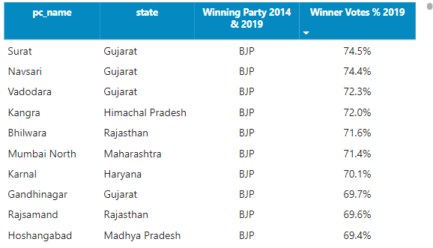
3. Which constituencies have the elected the same party for two consecutive elections, rank them by % of votes to that winning party in 2019
336 constituencies have elected the same party in 2014 and 2019.
This includes BJP – 239 constituencies (71%) and INC – 19 constituencies (5.6%) winning again.

Slide 8
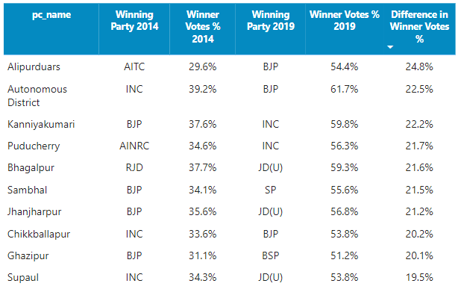
5. Which constituencies have the elected for different parties in two elections (list top 10 based on winner vote % in two elections
175 constituencies have voted for a change in the 2019 elections.
Out of which 45 constituencies have elected for BJP (25%) and 30 constituencies to INC (17%) in 2019.

Slide 9
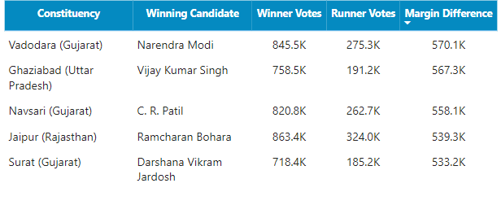
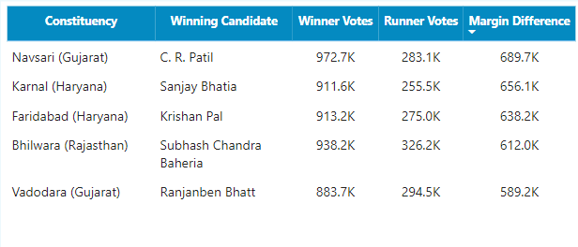
5. List top 5 candidates based on margin difference with runners in 2014 and 2019
For 2014,
For 2019,
C. R. Patil has won significantly in both the elections for the constituency of Navsari. This may be due to his strong political base , party affiliations with BJP etc.
Narendra Modi has won with the greatest margin of 0.57 million votes.

Slide 10
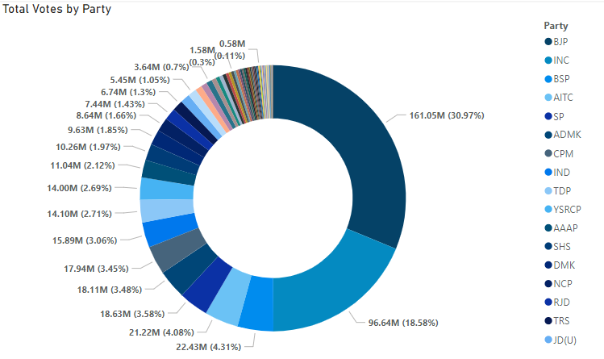
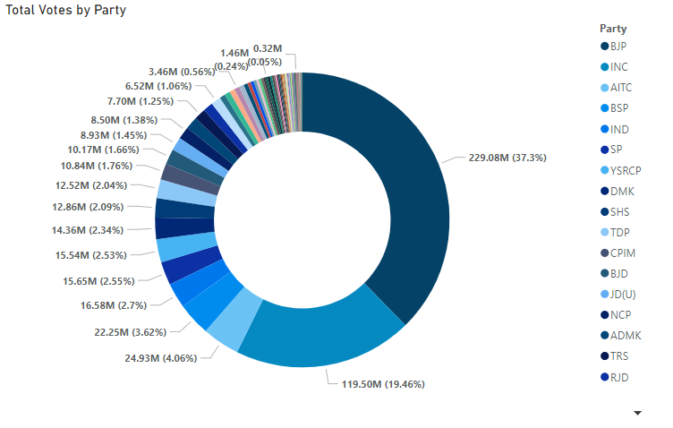
6. % split of votes of parties between 2014, 2019 at national level
For 2014,
For 2019,
BJP, INC have remained the major national parties in India in both the elections.
BJP has gained its vote share by nearly 6.3% in 2019 while INC has gained nearly 0.8% vote share at national level.
Together they contributed to more than 50% vote share in both the elections.

Slide 11
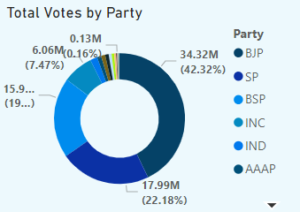
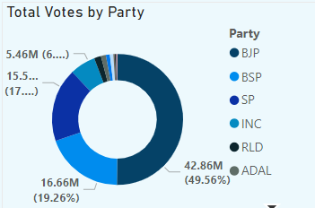
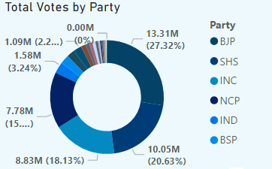
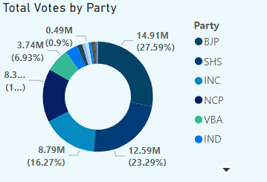
7. % split of votes of parties between 2014, 2019 at state level
2014
2019
Uttar Pradesh
2014
2019
Maharashtra

Slide 12
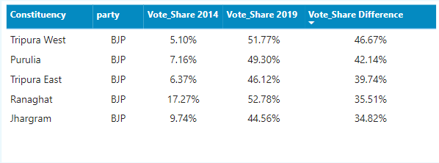
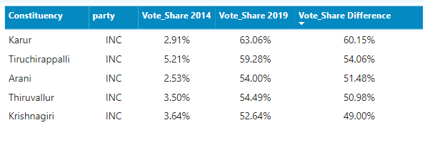
8. List top 5 constituencies for two major national parties where they have gained vote share in 2019 compared to 2014
For BJP
For INC
BJP has gained its vote share majorly in the North-eastern regions of India like Tripura and West Bengal
in the 2019 elections.
While INC has gained its vote share in the regions of Tamil Nadu.

Slide 13
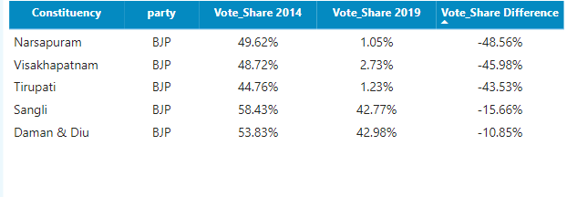
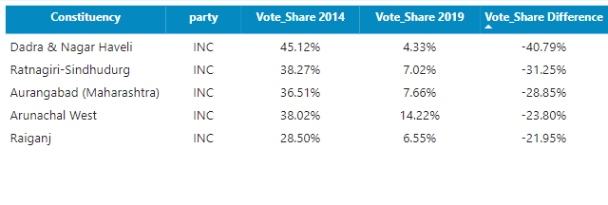
9. List top 5 constituencies for two major national parties where they have lost vote share in 2019 compared to 2014
For BJP
For INC
BJP has lost its vote share majorly in Andhra Pradesh which might be due to the influence of regional political parties like TDP and YSRCP.
While INC has lost its vote share in various constituencies due to the rise of BJP and other regional parties.

Slide 14
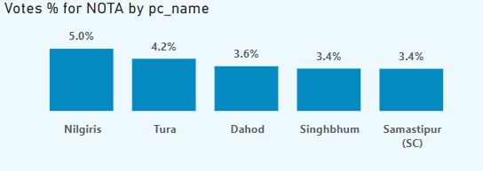
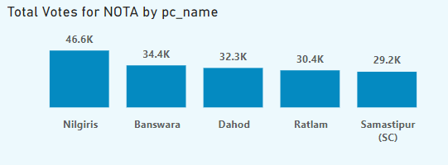
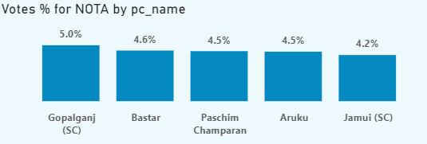
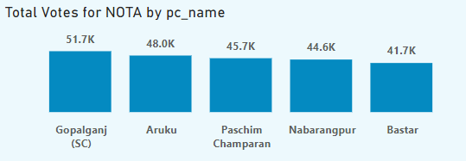
10. Which constituency has voted the most for NOTA
For 2014,
For 2019,

Slide 15
Vote Share of NOTA
NOTA stands for None of the Above – People opt for NOTA when they do not have any preference of the candidates contesting in their constituency
People express their dissatisfaction with the current politicians which can lead to a higher number of votes for NOTA.
If NOTA gets the most number of votes in a constituency, the next candidate with the second most number of votes is declared the winner
In 2014 and 2019 elections, we can see that most of the constituencies with tribal population has the highest vote share for NOTA like Aruku, Dahod, Tura, Singhbum etc.
This may be due to the issues related to tribal welfare and development, displacement of tribal population for infrastructure development, mining etc.

Slide 16
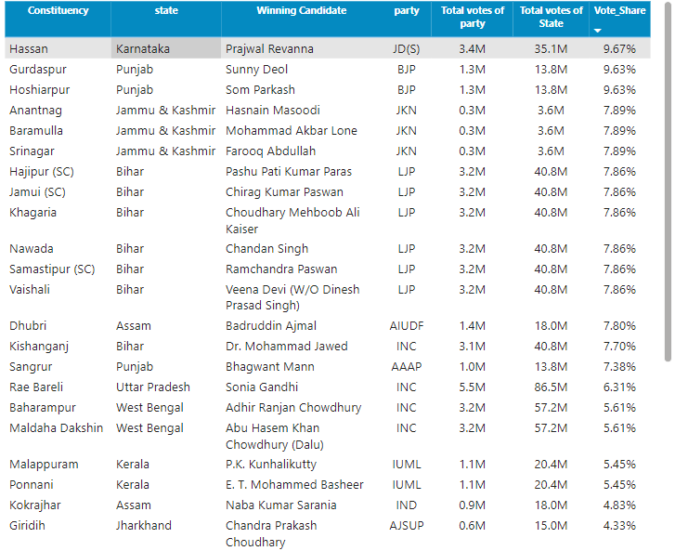
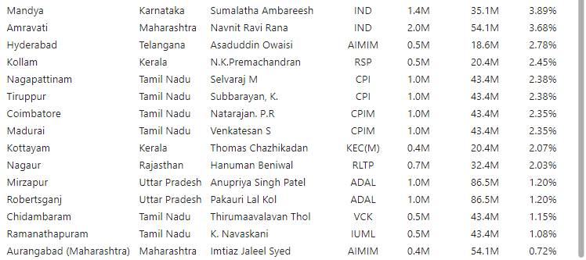
11. Which constituencies have elected candidates whose party has less than 10% vote share at state level in 2019

Slide 17
Correlation Analysis
Correlation refers to the degree in which two variables are related. Its range is -1 to +1.
-1 indicates strong negative relationship while +1 indicates strong positive relationship while 0 refers to no relationship at all between the 2 variables.
The correlation between Postal Votes % and Voter Turnout Ratio is approximately 0.15 average of both years) which tells a weak positive correlation between the 2 variables meaning as postal votes % increases the polling % also increases slightly.
The correlation between Literacy Rate % and Voter Turnout Ratio is approximately 0.26 (average of both years) which tells a weak positive correlation between the 2 variables meaning as literacy rate increases the polling % also increases slightly.
The correlation between GDP and Voter Turnout Ratio is approximately -0.48 (average of both years) which tells a moderate negative correlation between the 2 variables meaning as GDP increases the polling % decreases moderately.

Slide 18
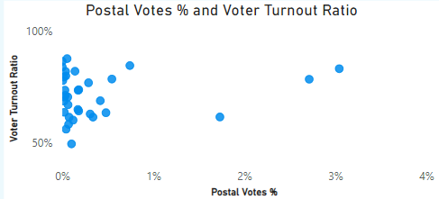
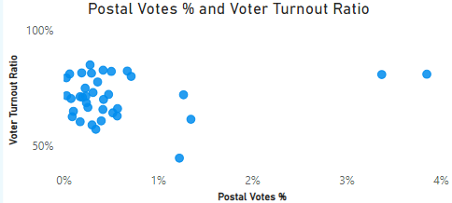
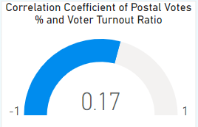
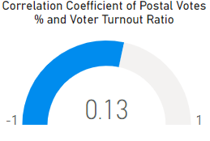
Secondary Analysis
1. Is there any correlation between postal votes % and Voter Turnout %
For 2014
For 2019

Slide 19
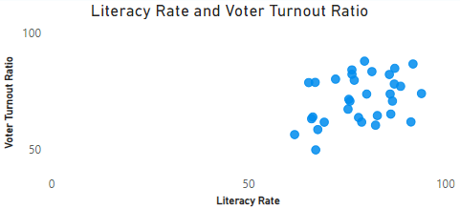
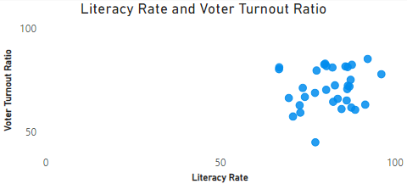
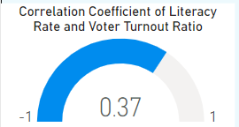
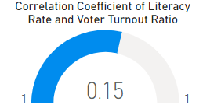
Secondary Analysis
2. Is there any correlation between literacy rate and Voter Turnout %
For 2014
For 2019

Slide 20
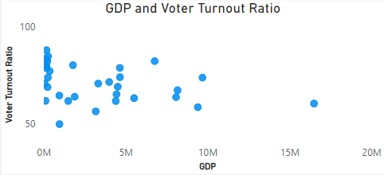
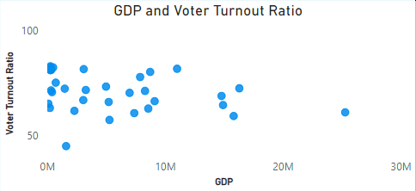
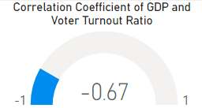
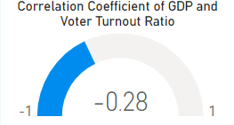
Secondary Analysis
3. Is there any correlation between GDP and Voter Turnout %
For 2014
For 2019

Slide 21
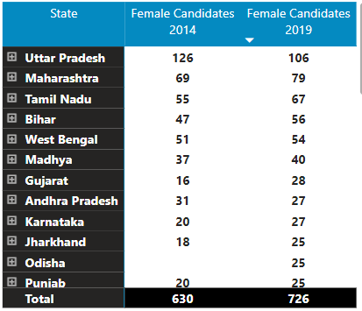
Though the North-eastern parts have shown a higher polling %, the participation of women in the elections is very less.
This might be due to their economic disadvantages, socio-economic norms and lower literacy rates.
UP, Maharashtra , Tamil Nadu have consistently shown the participation of women which might be due to urbanization, higher literacy rates and effective government schemes aimed at women’s welfare and development.

Slide 22
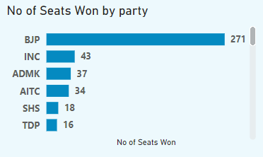
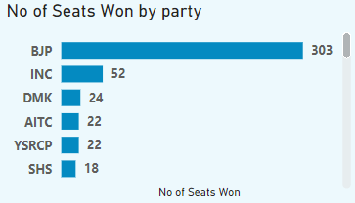
BJP, lead by Mr. Narendra Modi had a landslide victory in both the elections of 2014,2019 with 282 (including Odisha -1 and Chhattisgarh -10 ) and 303 seats respectively, surpassing the majority mark of 272 seats.
He won 2 seats (Vadodara, Varanasi) in 2014 and Varanasi constituency in the 2019 elections significantly.
INC, lead by Rahul Gandhi suffered a heavy loss with less than 20% vote share in both the elections.
He won in Amethi constituency in 2014 ad Wayanad constituency in 2019 with a margin victory of 40% and 12 % respectively.

Slide 23
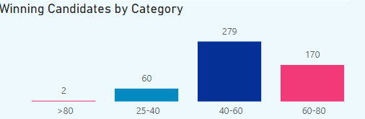
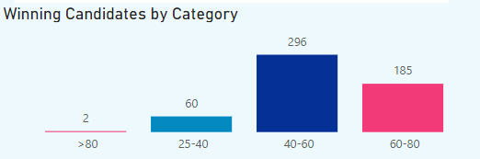
Winning Candidates by Age Group
\
The age group of 40-60 comprises the largest number of winning candidates in both the elections thereby indicating the dominance of middle-aged politicians in elected positions.
It also shows that there is a significant number of winning candidates who are elderly (60-80) accounting to nearly 32% followed by representation of younger candidates (nearly 11%).
The diverse age representation in political leadership underscores the importance of implementing policies that can cater to the needs and aspirations of citizens across all age groups.

Slide 24
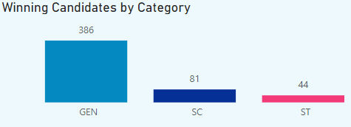
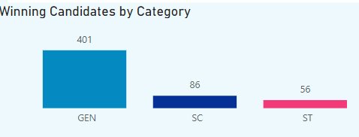
Winning Candidates by Category
There is a significant increase in the number of winning candidates across all categories.
SC has contributed to nearly 15% of winning candidates and ST to nearly 9% in both the elections.
The increase in winning candidates across all categories suggests a progressive trend in political representation, aiming for a more inclusive and diverse political landscape.

Slide 25
Online Voting: Explore secure online voting options to provide greater flexibility for voters.
Recommendations
Educating people the importance of voting and how a single vote can significantly create an impact in the electoral process.
Reminder emails or messages to the voters to encourage voting. It can contain information like nearest polling station, date and hours of operation.
Enhanced accessibility of polling stations by increasing the number or deploying mobile polling stations for the people in rural areas.
Enable secure online voting options to offer more flexibility and ease for the voters.
Ensure effective strategies for queue management, so that people don’t have to wait for longer hours to cast their thereby causing dissatisfaction.

Slide 26
THANK YOU!

